Slide 1
R Workshop: EDA Introduction to R and Data Management

Slide 2
Background
Large FMCG company
Pan country presence
3 business lines- Ice Cream, Chocolates and Cakes-Biscuits
Large amount of data is available
How can we leverage the data for scientific decision making?

Slide 3
Supply Chain
Company
Wholesalers
Retailers
Consumers
‘Customer’ in our case study

Slide 4
Data Snapshots
Monthly NSV Data
Customer Profile Data
NPS Data
In addition market survey data is available for 107 customers. The survey
recorded ‘Net promoter Score’ .
Net Promoter Scores are based on response to single question (0-10 scale)
How likely is it that you would recommend [brand] to a friend or colleague?

Slide 5
Understanding FMCG Data
Import 3 data sets CUST_PROFILE,NSVDATA and NPSDATA
Understand the contents of the datasets by observing variables, no. of rows, etc.
Check the variable types.

Slide 6
Import 3 data sets - R Code
#import NSVDATA in R
nsv<-read.csv(file.choose(),header=T)
#import CUST_PROFILE in R
cust<-read.csv(file.choose(),header=T)
#import NPSDATA in R
nps<-read.csv(file.choose(),header=T)
#apply functions like head,dim,str,summary to understand data characteristics.

Slide 7
1. Show Number of Unique Customers
What is the number of customers in each of these three datasets?
Important to note that there are repeated customer id’s(CUSTID) in NSV data
R Functions to be used:
Length and Unique

Slide 8
R Code and Output
length(unique(nsv$CUSTID))
#answer: 14077
length(unique(cust$CUSTID))
#answer:15001
length(unique(nps$CUSTID))
#answer:107

Slide 9
2 & 3. Campaign List Generation
Business Objective: To give recognition to customers, send sms to top 10 performers for their high annual sales in 2014
Functions to be used:
aggregate, order, head
___________________________________________________________________________________________________
Business Objective: To motivate non performing customers, send sms to bottom 10 dealers for their low annual sales in 2014
Functions to be used:
aggregate, order, head

Slide 10
Q 2 and 3: R Code
#aggregate sales in 2014 for each customer
agg_sales<-aggregate(NSV~CUSTID,data=nsv,FUN=sum)
head(agg_sales)
#sort in descending order and display top 10 performers
smstop<-agg_sales[order(-agg_sales$NSV),]
head(smstop,10)
#sort in ascending order and display bottom 10 performers
smsbottom<-agg_sales[order(agg_sales$NSV),]
head(smsbottom,10)

Slide 11
Q 2 and 3: R Output

Slide 12
4. Distribution of Top 100 across Region
Business Objective: Evaluate the performance of Regional Sales Managers on the basis of top 100 performers
How are the Top 100 customers distributed across Regions?
Functions to be used:
Merge, order, table

Slide 13
Q4: R Code
#merge agg_sales data with CUST_PROFILE data
mapped<-merge(agg_sales,cust,by="CUSTID")
head(mapped)
#sort in descending order and store top 100 performers
top<-mapped[order(-mapped$NSV),]
top100<-head(top,100)
#Frequency distribution of top 100 performers
table(top100$REGION)

Slide 14
Q4: R Output

Slide 15
Q4: R Output

Slide 16
5.Plot mean sales for customers in each Region
Business Objective: To enable quick inference for Management team, visually depict the dealers performance across Regions
Functions to be used:
aggregate, ggplot

Slide 17
Q5:R Code
region_sales<-aggregate(NSV~REGION,data=mapped,FUN=mean)
names(region_sales)
library(ggplot2)
ggplot(region_sales,aes(x=REGION,y=NSV))+
geom_bar(stat="identity",fill="blue")+
labs(x="REGION",y="MEAN NSV",title="REGIONWISE SALES")

Slide 18
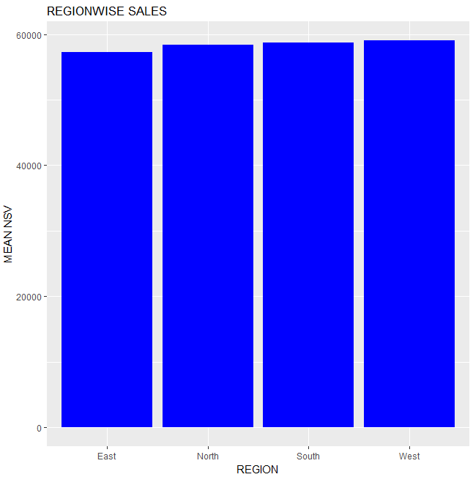
Q5:R output

Slide 19
6. Obtain LoB wise Contribution
Business Objective: Get insight on contribution to total sales by each Business Type (Line of Business)
Functions to be used:
aggregate, sum, derive a variable

Slide 20
Q6: R Code & output

Slide 21
7. Median NPS by Region
Business Objective: To understand Net Promoter Score in each region which can be indicator of loyalty with the company.
Median is an appropriate measure since NPS is measured as ordinal variable.
Functions to be used:
merge, aggregate

Slide 22
Q8.Code and Output

